Slide 1


TensorFlow Introduction: Duke-Tsinghua Machine Learning Summer School 2017
Kevin Liang
Duke University – Electrical and Computer Engineering
26 July 2017

Slide 2
TensorFlow: What is it?
A software library for machine learning
Computation using data flow graphs
Neural Networks
Released by Google November 9, 2015
An open source successor to DistBelief
Apache 2.0 License
APIs:
Python
C++
Java
Go

Slide 3
TensorFlow: Alternatives
Caffe
UC Berkeley (BVLC: Berkeley Vision and Learning Center)
Microsoft Cognitive Toolkit (CNTK 2.0)
Microsoft
Theano
Université de Montréal (MILA/LISA: Montreal Institute for Learning Algorithms)
Torch

Slide 4
TensorFlow: Why?
CPU/GPU/TPU support, easy to scale up
Large and active user-base
Academia, industry, enthusiasts
Rapid development, research, and support by Google
TensorBoard visualizations
Integration with Google Cloud Platform
Pre-trained models and high-level libraries (Slim, Keras, TFLearn)

Slide 5
TensorFlow: Tensors
Mathematics: Geometric objects defining linear relations
Generalization of vectors and matrices:
0th Order (Scalar): 8
1st Order (Vector): [4, 2, 9]
2nd Order (Matrix): [[5, 1, 9], [2, 2, 0]]
TensorFlow: unit for data and variables
0th Order: scalar_node = tf.constant(8.0, dtype=tf.float32)
4th Order: weights = tf.Variable(tf.random_normal([3, 3, 256, 512]), name=“conv_weights”)

Slide 6
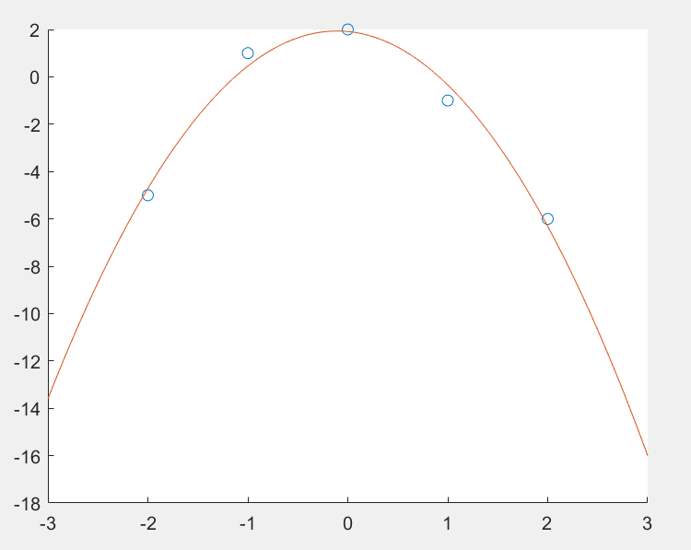
TensorFlow: Data Flow Graphs
Typical computational program operates directly on the data:
Python:
import numpy
x = [-2, -1, 0, 1, 2]
y = [-5 , 1, 2, -1, -6]
p = numpy.polyfit(x, y, deg=2)
# y_hat = p[0] * x**2 + p[1] * x + p[2]
Note that operations were performed on the variables holding the data itself

Slide 7
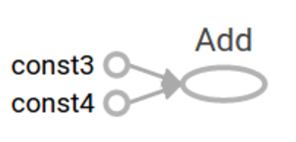
TensorFlow: Data Flow Graphs
TensorFlow: 2 steps
Define a graph:
a = tf.constant(3.0, dtype=tf.float32)
b = tf.constant(4.0, dtype=tf.float32)
sum = tf.add(a, b)
Run the graph and get outputs:
sess = tf.Session()
print(sess.run(sum)) # Prints “7.0” to the screen
sess.close()
More examples in tutorial: 02_TensorFlow_Basics.ipynb

Slide 8
TensorBoard: Graph Visualization

Slide 9
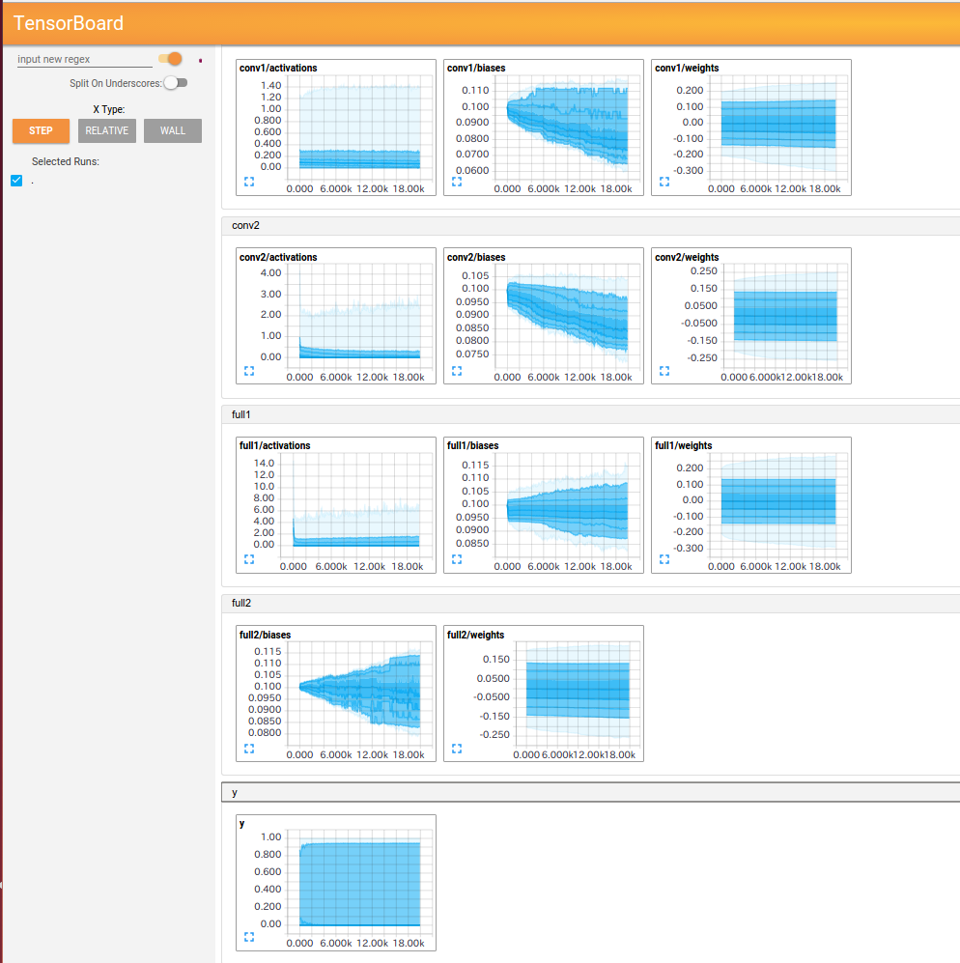
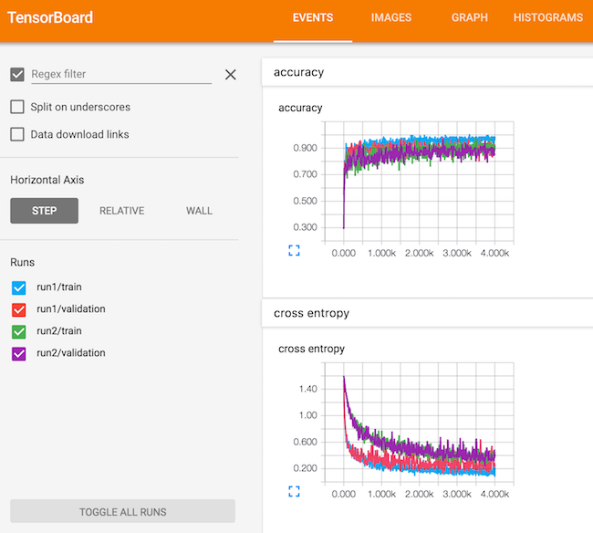
TensorBoard: Monitor Training

Slide 10
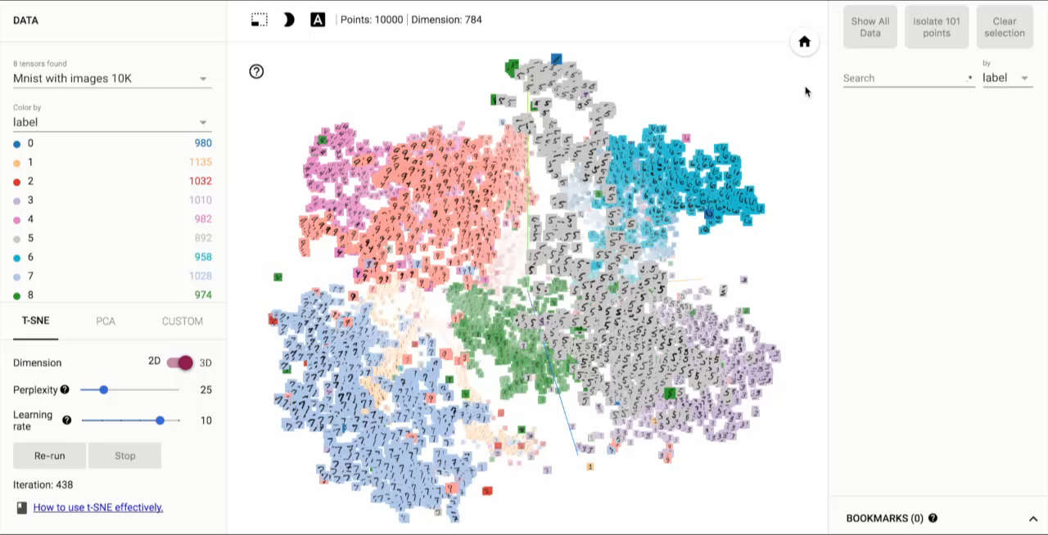
TensorFlow: Data Flow Graphs

Slide 11
Questions?

